Slide 2
Why I have Chosen this Topic
Normally when talks or books cover Egypt, the focus, always, is on events, problems, achievements, no achievements, and so on and so on.
Instead what needs to be focused on is to address: Fundamentals, Bases, Foundations, and the like.
In other words, imagine Egypt as a Multi-Floor Buildings: Built, Being Built, or Planned to Be Built. All standing on Foundations that are strong enough to support the Multi-Floor Building.
Hence what I aim to propose is to change the focus, from addressing Floor by Floor, but to Focus on Egypt’s Foundations and long lasting Basis.
Accordingly, the Topic : Egypt You Have No Match Focusses on Egypt’s Foundations, Pillars and Long-Lasting Basis.

Slide 3
What are the Main Topics Addressed?
1 - What is Meant by “Egypt: You Have No Match”?
2- Based on Egypt’s Main Geo-Strategic Pillars, Egypt’s
Geo-Political Nile-Based Status is addressed.
3- Attention is then turned on the Uni- Multipolar Security Structure, and The US, as the only Superpower, Grand Macro Middle East Strategy.
4- Back to Egypt, Reviewing Egypt’s Pivot State, Past,
Present, and what its Future Pivoting Behavior should be?
5- Focusing on the Future, a “Five-Pronged Pivoting Strategy” is recommended,
6- Then an Optimistic Conclusion of “Egypt: You Are
Great as Always”.

Slide 4
Key Definitions
• Geo‐strategy: Specifically, is a subfield of geopolitics, is a type
of foreign policy guided principally by geographical factors, as
they inform, constrain, or affect political and military planning.
As defined by Zbigniew Brzezinski the “words geopolitical,
strategic, and geostrategic are used to convey the following
meanings: geopolitical reflects the combination of geographic
and political factors determining the condition of a state or
region, and emphasizing the impact of geography on politics;
strategic refers to the comprehensive and planned application
of measures to achieve a central goal or to vital assets of
military significance; and geostrategic merges strategic
considerations with geopolitical about securing access to
certain trade routes, strategic bottlenecks, rivers, islands and
seas. It requires an extensive military presence and power.
• Geodynamics: is a more neutral and broader term than the more familiar‐ but, also, more value‐laden‐ geopolitics.
Geodynamics refers to ongoing dynamic patterns and trends in various key aspects of the international system. Five key aspects are focused on: geo‐economic, geo‐political, geosocietal, geo‐judicial, and geo‐indentations.
• Now‐casting: is the prediction of the present, the very near
future and the very near past in economics. The term is a
contraction of “now” and “forecasting” and has been used for a
long time in meteorology. It has recently become popular in
economics as standard measures used to assess the state of an
economy, e.g. gross domestic product, are only determined
after a long delay. In sum, nowcasting, as opposed to
forecasting, describes the process of monitoring, depicting, and
analysing ongoing developments in international relations as
they occur.

Slide 5
Egypt Multi-Pillars
• Strategically: Unique Pivotal
• Economically: Potentially Prosperous
• Historically: Oldest Civilization
• Culturally: More the 10,000 years of amazing blend of Culture
• Artistic: A unique unmatched Beauty
• Geographic: Heart of The World
• Population: Intrinsically Intelligent with Fascinating Sense of Humour
• Socially: Very Friendly, Peaceful & Homogeneous
• Faith: Multi-Loving Faith
• Holly Books: Named Repeatedly
• Inventions: The First Inventor in History
• Ethical & Moral Standards: Truly Imbedded in Her Identity
• Patriotism: In Her People’s Blood
• Future: Potentially Glorious
These Pillars Are Personal Themes, until Analytically addressed.
In this Talk, attention is focused on the Geo-Strategic Pillar.

Slide 6
Egypt Have No Match Compound, Consistent & Conditional
• “Have No Match” Does Not Mean No Match in Each Pillar, But “Compound”
• Also, Should Not Be Regarded as intrinsically, fully and Totally Unconditional.
• In addition to being “Compound & Conditional”, It should have high degree of internal Consistency.
• Hence, based on considering the Pillars on a Compound, Conditional & Consistent, it is hypothesized that: Egypt as Having No Match

Slide 7
Egypt’s Geo‐Strategic Status
1‐ Egypt’s Geo‐Strategic Status is Nile and location‐ based status.
2‐ Egypt is a “challenged‐gift of the Nile”. While critical to Egypt’s survivability, being full of obstacles and sensuous make a very challenging one, in many respects, particularly Defense‐wise.
3‐ Location‐wise, Egypt is at cross‐roads of many continents and countries with many rising conflicts of interests. This, also, places Egypt in a challenging geo‐Strategic challenges of trying to remain not perceived hostile.
4‐ The imperatives of Nile and location‐ based challenges are for Egypt to have a very strong army.
5‐ Fortunately Egypt has one of the strong armies in the world, and has a unique and unmatched defense philosophy , which I call “Proactive Peace”.
6‐ That is: seeking genuine peace from a position of strength, and adopting broad definition of strength, borders/wise and domestic stability‐wise.

Slide 8
The World’s Multipolar Security Status
1‐ Not Bi‐polar since the end of the Cold War.
2‐ While the US became the only Superpower, the system did not become the Unipolar one. The US can not make world’s security decisions alone.
3‐ Neither is it a Multipolar one, as other great powers can not make Security decisions alone.
4‐ It is a Multipolar Security System. The US needs the support of other Great Powers, on one hand, but, on the other hand, the US is the Only country that can Veto, alone, any security‐related decisions.

Slide 9
The US Middle East Strategy
1‐ The Stable Disequilibrium Strategy. Ensuring no repeat of the October War, even without ensuring the solution of regional problem. Stability is relying on singular Israeli’s Nuclear Power.
2‐ The Dual Strategy of the Gulf: Geopolitical, preventing Iran becoming Nuclear, and, Economic Oil‐Focused. All routes lead to Tehran!!
3‐ Construction/Creative Anarchy to create New States in the Middle East serving solely the interests of the US.
4‐ The Terrorism Equation: Terrorism is a function of oil‐based wealth and Islam. The target is Saudi Arabia.
5‐ The New Middle East and the return to the “Two Policemen of the Area”, and the “Pivotal Legitimizer”.

Slide 10
Pivot States
Definition, Identification, Ties to Bind, Relationships that Flow and Behaviour
1‐ Pivot States can be defined analytically, and identified empirically. In both cases it starts with , and relates to, Great Powers.
2‐ Analytically, and focusing on the US as the Great Power, Robert Chase defines a Pivotal State as a state with “capacity to affect regional and international stability.”
3‐ Empirically, the two The Hague’s studies identification of Pivot States centres on Great Powers, Strategic Goods, Ties to Bind, Relationships that Flow, and Behaviour.
4‐ The empirical calculation relies on Military, Economic and Ideational Strategic goods, and related Ties and Flows.
5‐ As to Behaviour, two are of interest to this talk: one is Pivoting, and the other is Stable; I.e Pivoted for a Significant Period.
6‐ Pivoting means not aligned to any specific Great Power, while Pivoted means allied to a specific power only.

Slide 11
Egypt: a Pivot State
1‐ Analytically, both Robert Chase and Roger Owen, focusing on the US as the Great Power, argued, most strongly and eloquently, for selecting Egypt as a “Pivotal State” in both regionally and internationally, in both positive and negative aspects.
2‐ Empirically, Great Powers were identified in the first study, 2012,as; the US, Russia, China and the 28 EU countries. In the second study, 2015, India and Japan was added.
3‐In the first study Egypt was identified, amongst 33 countries and 35 countries in the 2nd study, as: Pivoting in the 1st Study, and Stable (Pivoted) in the 2nd study.
4‐ in both studies the selection of Egypt did not include Economic Strategic goods, which is a weakness that must be reminded.
5‐ Identified Egypt Behaviour in the recent study as Stable Pivoted aligned solely to the 28 EU countries is also totally unacceptable that must be remedied.
6‐ Both weaknesses are remedied by adopting the Five‐Pronged Strategy.

Slide 12
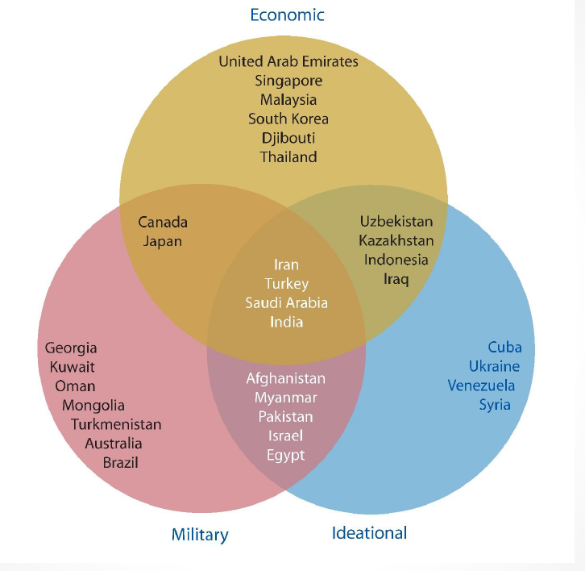
Figure 1.1

Slide 13
Aims of Egypt’s Five‐Pronged Strategy
1‐Pivotal Egypt Versus Great Powers:
Strengthening Egypt’s International
Negotiating Power,
2‐ Pivotal Egypt Versus Pivotal Israel:
Restore Regional Balance of Power
And Aim to Achieve M.E. Peace.
3‐ Pivotal Egypt Versus Pivotal Iran:
Strengthening Regional Stability.
4‐ Pivotal Egypt Versus Other Pivotal
States: New Pivotal Alliances, and
5‐ Pivotal Egypt Versus Pivotal Egypt:
Strengthening Domestic Foundations.

Slide 14
List of Proposed Five‐Pronged Strategy For Egypt
1‐ A Quasi‐Pivoted Strategic Relationship Between Egypt, and The U.S. and Britain,
2‐ A New Framework for Just & Lasting Peace in the Middle East,
3‐ A Special Regional Relationship with Iran,
4‐ Pivoting‐Pivotal Dynamic Alliance, and
5‐ Stable Growth and Sustainable Fairness to consolidate the Pivoting Strategy.

Slide 15
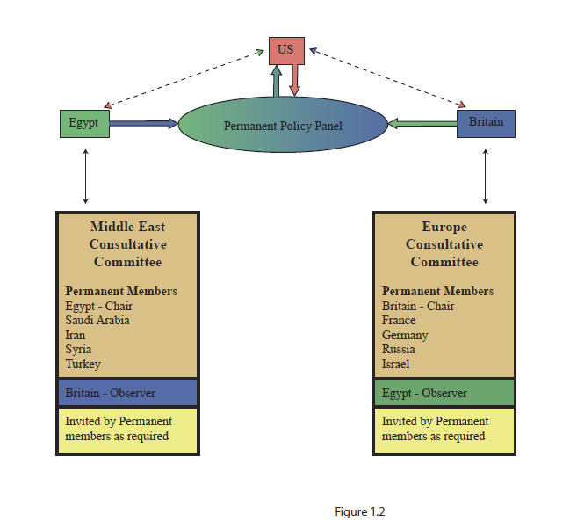
(C) Uni-Multipolar Consultative and Policy Structure

Slide 16
Figure 1.3 Summary of the Five-Pronged Strategy
US
UK
special
relationship
A quasi – pivoted strategic
relationship
EGYPT
PIVOT – PIVOTING
STATE
ISRAEL
IRAN
Pivoting - pivot
Pivoting - pivot
Framework for justice &
lasting peace in M. E.
Special regional
Relationship with
Pivoting
Consolidation
EGYPT
CHINA, RUSSIA, INDIA, JAPAN, S. AFRICA, BRAZIL, MALAYSIA
Pivoting - Pivotal
Stable growth &
Dynamic alliances
Sustainable fairness

Slide 17
Egypt: You Are Great as Always
You Are Not Only the Mother of the World
But, you are, in fact, the World
*******************
To you, my most Beautiful Love, I Say: May
Your Unique sun bring you more energies by day,
*******************
May your stunning Moon Restore You at Night,
May Your Refreshing Rain Wash Away any Worries you have,
********************
May your Gentle Jasmine’s Breeze Restore Your Sacred Soul, and
May Glorious Tomorrow Always Find You Feeling Better the Day Before,
********************
AMEN

Slide 18
Proposed Questions for Open Discussion
1- Egypt has the Potential to Change from a Pivoting State to a Great Power by 2025/2030? Do You Agree? And What Action Plan is Required to Achieve it?
2- Should the Israelis and the Palestinians, Together, Rise Against their respective Corrupt Governance system? Do you Agree this as a prerequisite necessary requirement achieving just and lasting peace in the Middle East?
3- Should A New Form of a Bagdad Pact, led by Egypt, from Iran to Egypt be
considered?
4- Should Egypt try to lead a New Positive Neutral Alliance, to include, but not to be limited to: India, Brazil, South Africa and South Korea?
5- Should Egypt Aim to become the Main Economic Ally with Great Britain after Brexit, in the Mediterranean and Africa?
6- Should Egypt Aim to become a World Singapore’s Mediterranean Energy Centre?

Slide 19
Proposed Questions for Open Discussion
7- Are the Egyptians Overseas willing to provide, at least, one month a year Free of Charge expert service to Egypt’s Government’s Entities? I am sure, they would be happy to do. Should not the Law change to implement it?
8- Should Egypt consider the Military Option should no peaceful fair solution is not reached in relation to the Renaissance (Al Nahda) Dam?
9- Should Egypt become a regional Nuclear Power? Given Israel’s Nuclear and Thermonuclear Weapon’s Arsenal and its Offensive Military Strategy!!Or,
10- For the Egyptian Army to advocate, at least regionally, its Unique Philosophy of “Pro-Active Peace”, with its Strong/Constructive Arms: The Strong Military Arm, and The Constructive Civil, Economic and Social Arm?
11- What about Egypt Hosting a Future Football World Cup, particularly as a relatively minute country managed (?) to achieve it?
12- Last, but not least, what about aiming to achieve at least 10 million pilgrimage following the footsteps of the Holy Family Journey in Egypt?

Slide 20
A Proposed Motion Dated
12Th July 2019 At
The Egyptian Cultural and Education Bureau
“We, the Egyptians residing in the UK and Friends of Egypt, who are attending the ECEB’s above event, herby confirm their willingness to enter, voluntarily, into an appropriate Agreement with the Government of Egypt. The Agreement aims to provide, free of charge, regular expertise services, detailed of which are to be covered in the said Agreement, which will be subject to appropriate and applicable Laws”.

Slide 21
Is it possible for Egypt to become A Great Power?
First: it should become not only Pivoting, but Proactive- Pivoting.
Proactive Pivoting Equation= Strategic Relations+ Stable Society+ Strong Economy+ Strong Army.+ Moderate Ideology.
The most essential first step in the implementation of such Proactive Pivoting equation should aim towards revival of Egyptian Nationalism to the boiling point. In few words, Egypt needs to return to the “golden age”; a return to the fever and zeal of Egypt’s 1919 Revolution, which was Nationalistic in every single detail.
This can be achieved by “Populism”. That is by “direct appeal to the people, , to their acquisitive and patriotic instincts over the heads of those who are jealous of Great Egypt and continue to spread grim and false fictions”
But, all this must be achieved calmly, orderly, and most importantly, peacefully.

Slide 22
Is it possible for Egypt to become A Great Power?
Second: With Proactive-Pivoting, becoming a Great Power is possible.
Then comes the question of Egypt rising from being “Pivotal/Pivoting “ to become “Great Power”. This is quite feasible.
Population-wise, Egypt compares well with Great Britain, France, Germany
Area-wise, it compares with all the above,
Geographically – unique
Resources - Ample Resources of very valuable characteristics, tourism for example,
Army- has one of the strong armies in the world.

